Slide 1
Subject | Mathematics
Grade | 2 year 2
Term | 2

Slide 2
LESSON PLAN CONTENT
Week 2 | Numbers, operations and relationships.
Week 3 | Numbers, operations and relationships.
Week 4 | Assessment week
Week 5 | Space and shape

Slide 3
LESSON PLAN CONTENT
Week 6 | Space and shape
Week 7 | Assessment week
Week 8 | Data handling
Week 9 | - Measurement - Patterns

Slide 4
LESSON PLAN CONTENT
Week 10 | Assessment week

Slide 5
LESSON OBJECTIVES
To use mathematical knowledge and skills learnt in the classroom and to apply them in the real world.
To equip the learners, irrespective of their socio background, race, gender, physical ability or intellectual ability, with the knowledge, skills and values necessary for self-fulfilment and meaningful participation in the society as a citizen of the free country.
Facilitating the transition of learners from educational institution to work in the community e.g. Community Development Worker (CDW) or a sheltered workplace.
It helps the teacher to be able to: • create a leaner’s profile of competences - the profile will bridge the gap between the home and the school; • identify what the learner knows, can do and demonstrate in the teaching and learning situation.
work effectively as individuals in/or a member of a team.
Communicate effectively or by using Augmentative Alternative Communication (AAC) and other communicative devices (Sign language, Braille, etc.

Slide 6
Assessment Goals
Numbers, operations and relationships. | - Count forward and backwards up to 30 from a given number. Identify number symbols and number names.
Numbers operations and relation ships | - Recognize and identify the South African coins. Addition and subtraction of money.
Space and shape | - Understand the position of one object in relation to another.
Space and shape | - Recognize and name 3D objects in the classroom and in pictures.

Slide 7
Assessment Goals
Data handling | - Sort out everyday concrete objects.
Measurement | Time - Talk about passing of time, sequence of events [start to use concepts like today and tomorrow].
Patterns | Copy and extend simple patterns using body percussions [ clapping, stamping]. Make simple patterns using 2D geometric shapes.

Slide 8
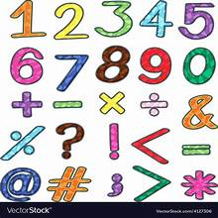
Numbers, operations and relationships.

Slide 9
Group 1
Color the following numbers from 1-20.

Slide 10
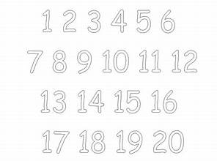

Slide 11
Group 2
Count while pointing the numbers from1-40 using the following chart.

Slide 12
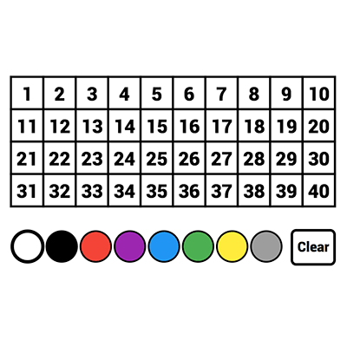

Slide 13
Group 3

Slide 14
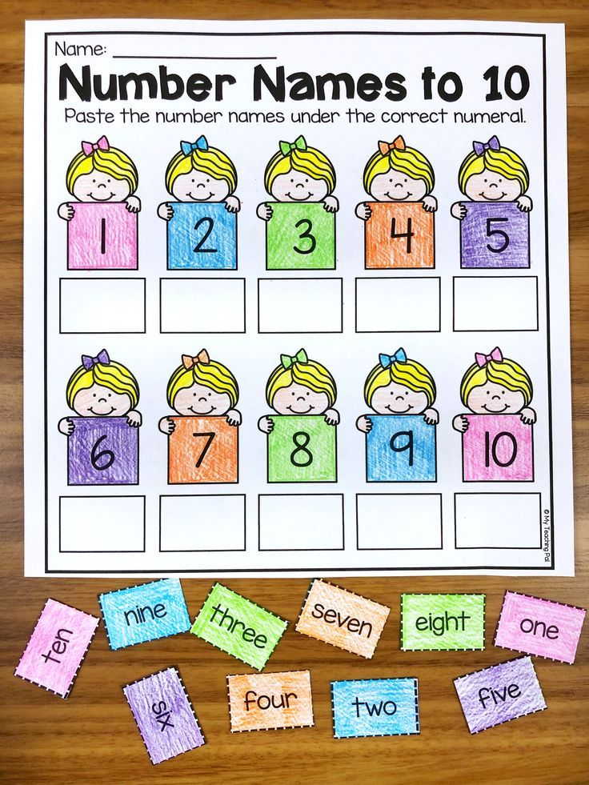

Slide 15
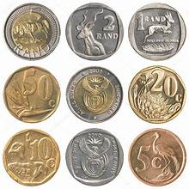
South African coins

Slide 16
Group 1

Slide 17
Activity:
The teacher will come with coins in the classroom and ask learners what coins do they see.

Slide 18
Group 2

Slide 19
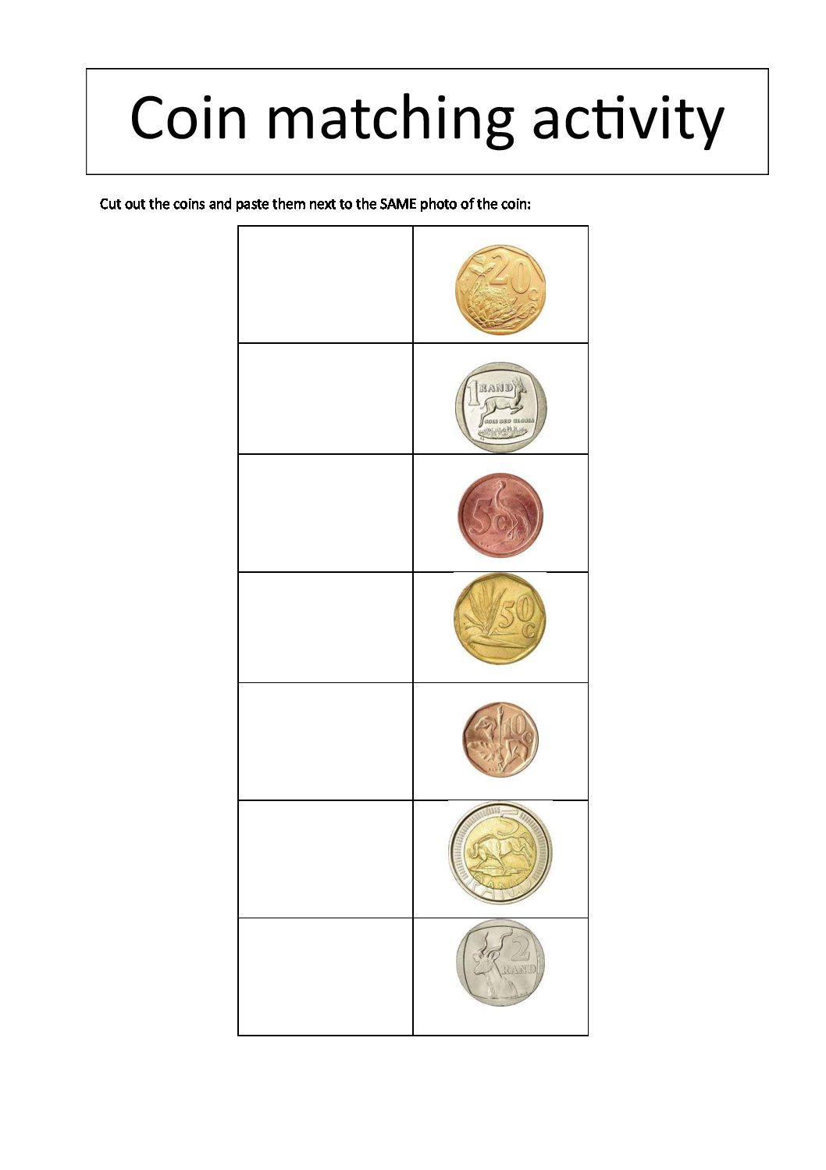

Slide 20
Group 3

Slide 21
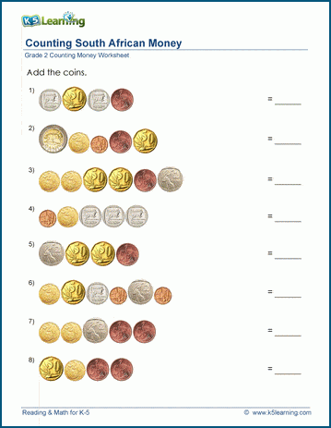

Slide 22
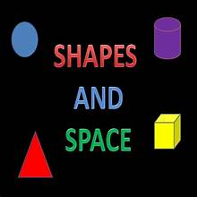
SPACE AND SHAPE

Slide 23
POSITIONS

Slide 24
Group 1

Slide 25
Activity:
The teacher will use objects in the classroom like chairs, desks, chalkboard, door etc. and demonstrate to learners about different positions that one object can display amongst other objects then ask learners to also demonstrate those positions.

Slide 26
Group 2

Slide 27
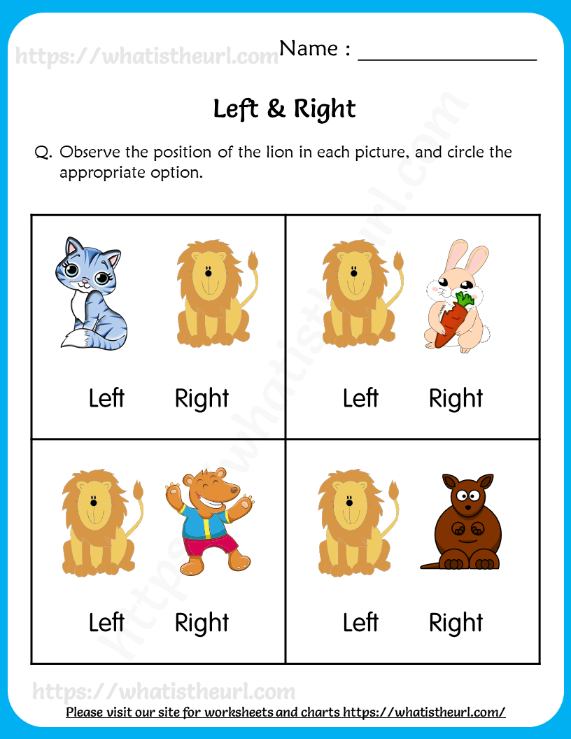

Slide 28
Group 3

Slide 29
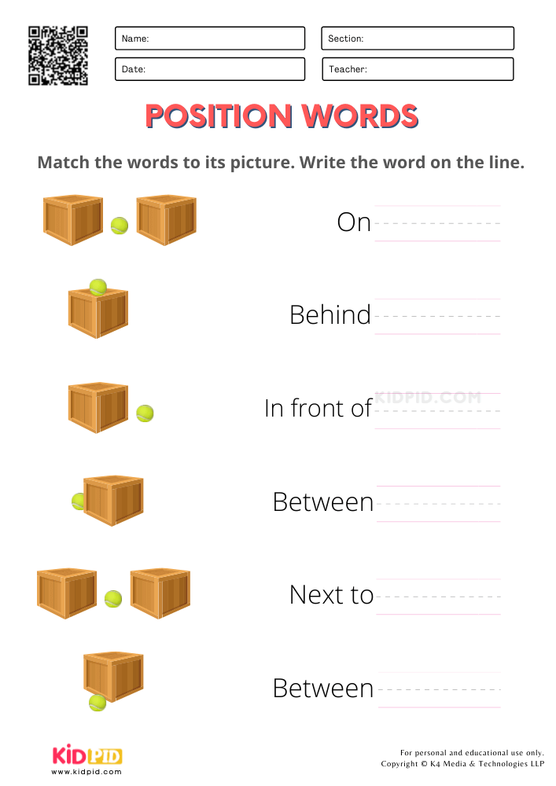

Slide 30
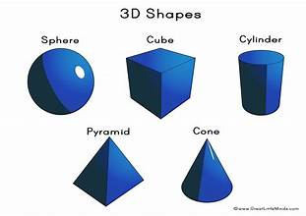
3D OBJECTS

Slide 31
GROUP 1
Color the 3D shapes.

Slide 32
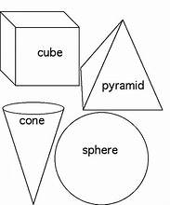

Slide 33
Group 2

Slide 34
Activity:
Name the 3D objects that you can see around the classroom.

Slide 35
Group 3

Slide 36
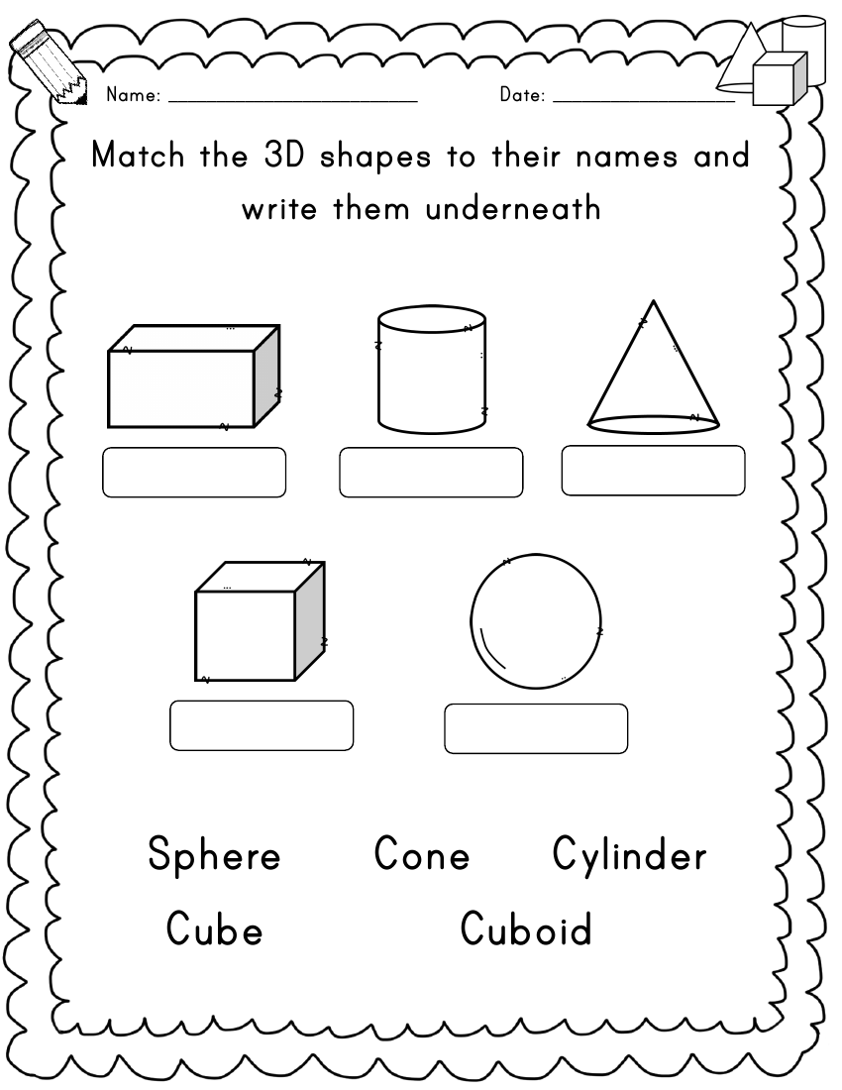

Slide 37

DATA HANDLING

Slide 38
Group 1

Slide 39
Activity:
Learners will be given counters with different color and they will have to sort and arrange those counters according to their colors.

Slide 40
Group 2

Slide 41
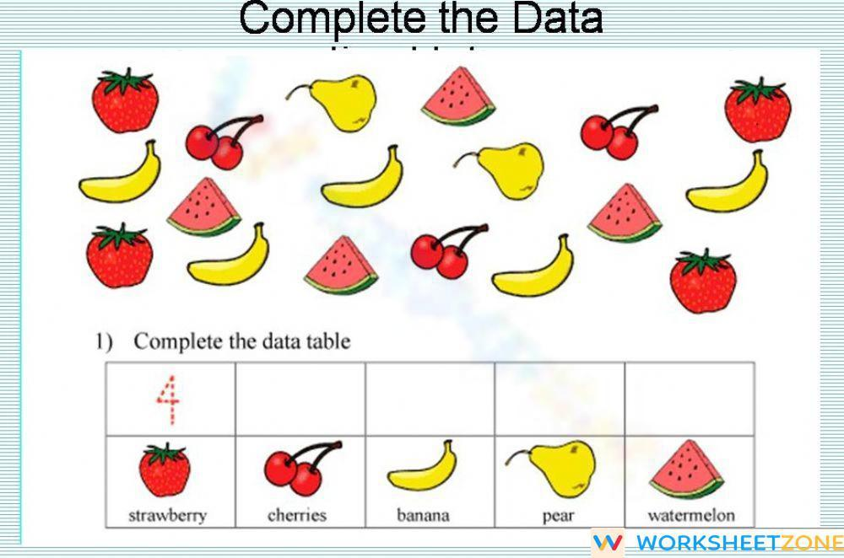

Slide 42
Group 3

Slide 43
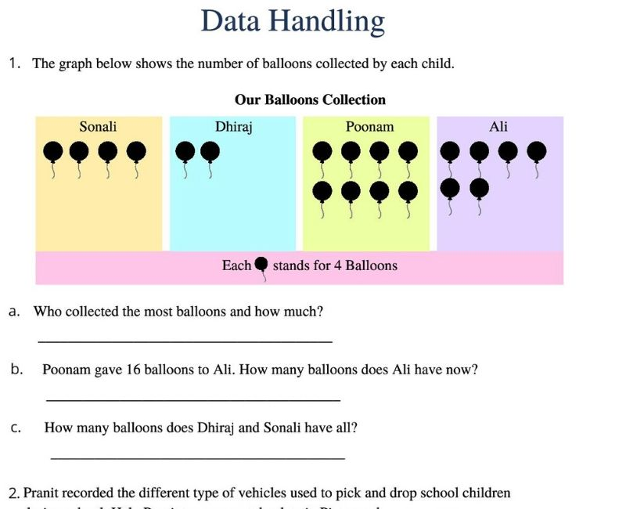

Slide 44

MEASUREMENTS

Slide 45
Group 1

Slide 46
Activity:
1. Tell us about the things you did yesterday at home.
2. What are you going to do today at school with your friends?
3. What are you going to do tomorrow after school?

Slide 47
Group 2

Slide 48
Activity:
1. Today is Friday, what day is tomorrow?
2. Today is Monday, what day was yesterday?
3. Yesterday was Wednesday, what day is today?

Slide 49
Group 3

Slide 50
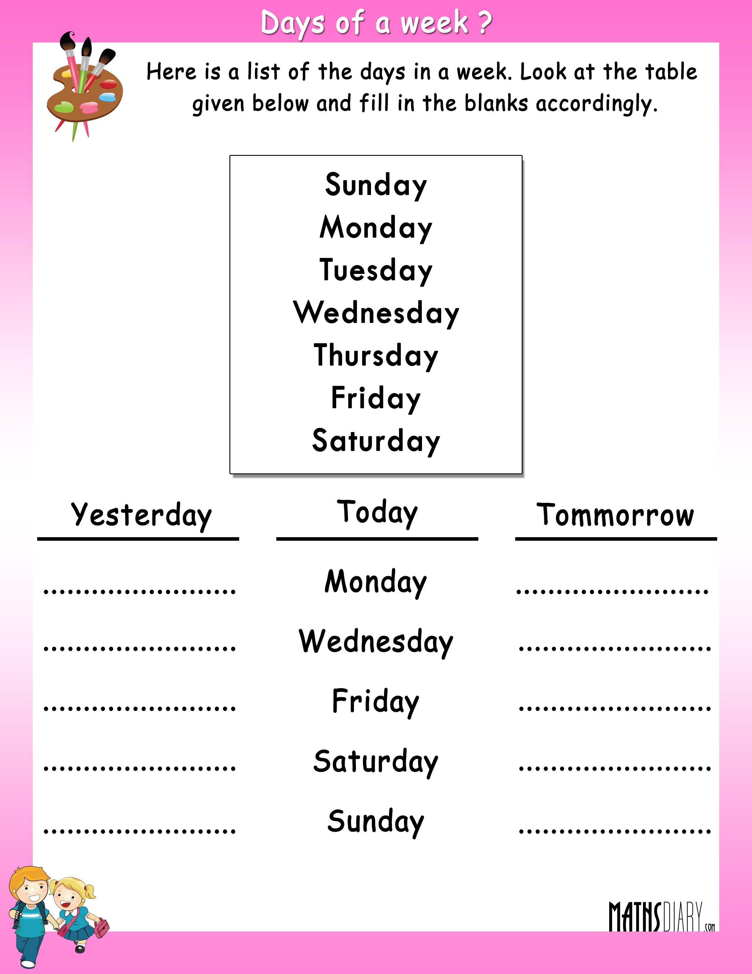

Slide 51

PATTERNS

Slide 52
Group 1

Slide 53
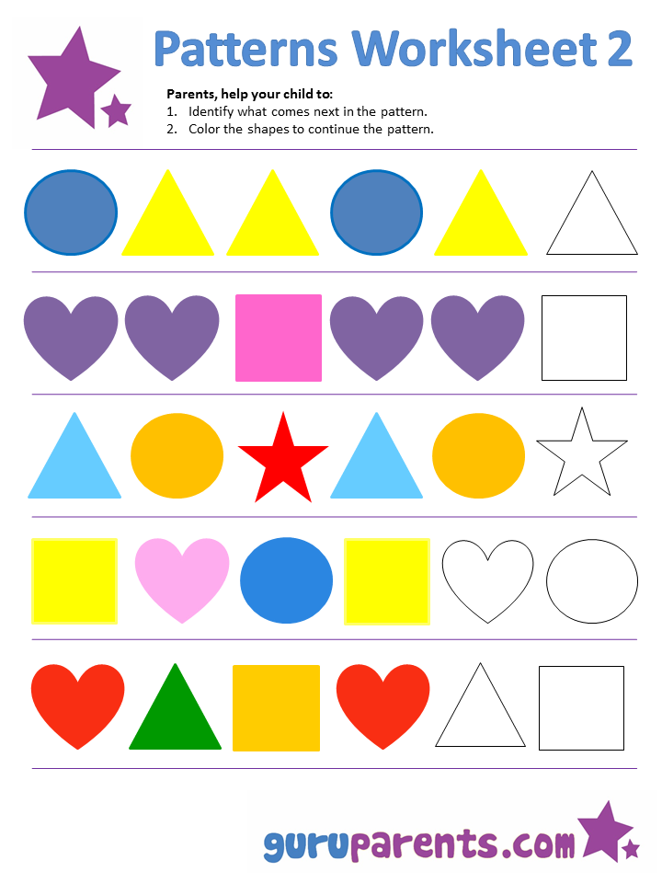

Slide 54
Group 2
Complete the following pattern by drawing the picture in the box.

Slide 55
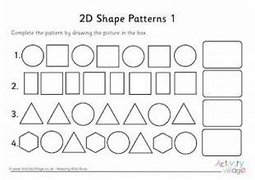

Slide 56
Group 3

Slide 57
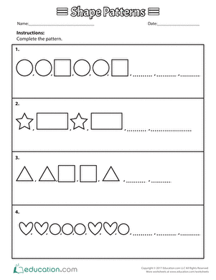

Slide 58
REFERENCES
https://tse1.mm.bing.net/th?id=OIP.xGKS3Rl7LV-kS8v9qqcRQwHaFg&pid=Api&P=0&h=220
https://tse2.mm.bing.net/th?id=OIP.pmj2R0guqGQdM8XR_mEhbAAAAA&pid=Api&P=0&h=220
https://whatistheurl.com/wp-content/uploads/2020/11/identifying-left-and-right-position-worksheet-3.png
https://www.kidpid.com/wp-content/uploads/2021/11/position-words-practice-worksheets-for-kindergarten-1.png
https://i.pinimg.com/originals/d1/da/a9/d1daa90e07d2810f087a5482d18f2b0b.png
https://storage.googleapis.com/worksheetzone/image/6221ff931becbd4e04bda302/data-handling-w1000-h662-preview-0.jpg
https://witknowlearn.com/cdn/images/thumbnail/handling-data-worksheet-for-grade-3-0-2020-11-07-061035.jpg
http://www.mathsdiary.com/wp-content/uploads/2015/08/days-of-a-week-worksheet-3.jpg
https://i.pinimg.com/originals/0c/89/e9/0c89e978bca96b271655ff48f801a3df.gif

